Slide 1


CAPSTONE PROJECT
Marketing Campaign Performance
Presented By
Student Name: rohan S
College Name: UBDT College of engineering
Department: cse
Email ID: rohanrodu@gmail.com

Slide 2
OUTLINE:
Problem Statement
Proposed System/Solution
System Development Approach
Algorithm & Deployment
Result (Output Image)
Conclusion
Future Scope
References

Slide 3
Problem Statement:
Organizations run multiple marketing campaigns without clear insight into effectiveness.
Difficulty identifying high-value customers and successful channels.
Need for data-driven decision making.
To identify key factors influencing the success or failure of marketing campaigns.

Slide 4
Proposed Solution:
Data Driven: Leveraging marketing campaign datasets containing customer demographics, campaign details, channel information, and response metrics.
Preprocessing: Cleaning and transforming data in Power Query by handling missing values, removing duplicates, and standardizing formats for accurate analysis.
Data Modeling: Building a structured data model with relationships between customer, campaign, product, and time tables.
KPI Definition: Creating key performance indicators such as impressions, CTR, conversion rate, campaign cost, and ROI using DAX measures.

Slide 5
Proposed Solution:
Optimization: Analyzing campaign performance across channels and segments to identify high-performing strategies and areas for improvement.
Visualization: Developing interactive Power BI dashboards with slicers, drill-down, and drill-through features for detailed insights.
Decision Support: Enabling data-driven marketing decisions by providing actionable insights to optimize future campaigns and budget allocation.

Slide 6
System Approach:
System Requirements:
  Python 3.x Environment
  Jupyter Notebook or VS Code or Google colab
  Power BI
  CSV Dataset
Libraries Required:
  Pandas: For data manipulation and CSV handling.
  NumPy: For numerical computations and array processing.
  Matplotlib: For creating customizable and low-level data visualizations.
  Seaborn: For statistical data visualization with attractive, high-level plots built on Matplotlib.

Slide 7
Algorithm & Deployment:
Algorithm.
Import marketing campaign data into Power BI from sources such as CSV files, Excel, or databases.
Clean and preprocess the data using Power Query
Build relationships between relevant tables
Create calculated columns and DAX measures to compute KPIs like CTR, conversion rate, cost per lead, and ROI.
Analyze campaign performance across different dimensions such as time, region, customer segment, and channel.
Visualize insights using charts, tables, slicers, and KPI cards in Power BI.

Slide 8
Algorithm & Deployment:
Deployment.
Publish the Power BI report to the Power BI Service.
Configure datasets and set up scheduled data refresh to keep reports up to date.
Create and share interactive dashboards with stakeholders using workspace access.
Apply row-level security (RLS) to restrict data visibility based on user roles.
Access dashboards via web or mobile devices for real-time monitoring of campaign performance.

Slide 9
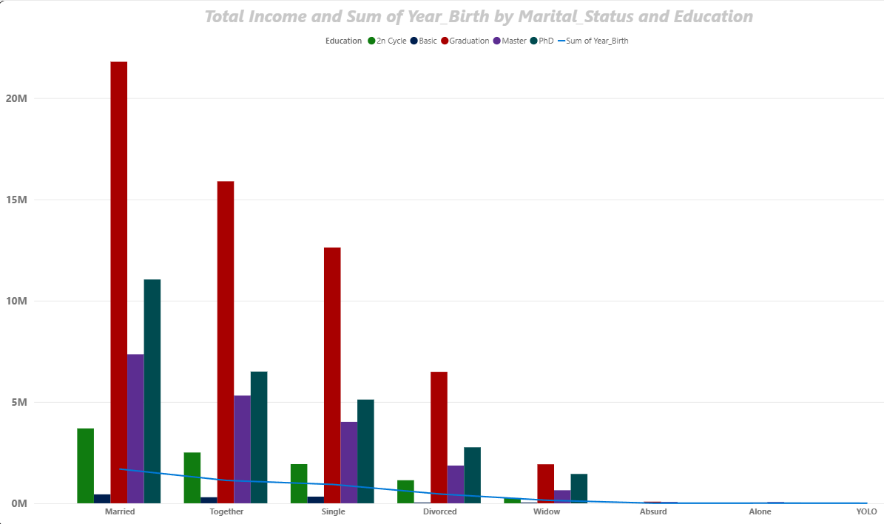
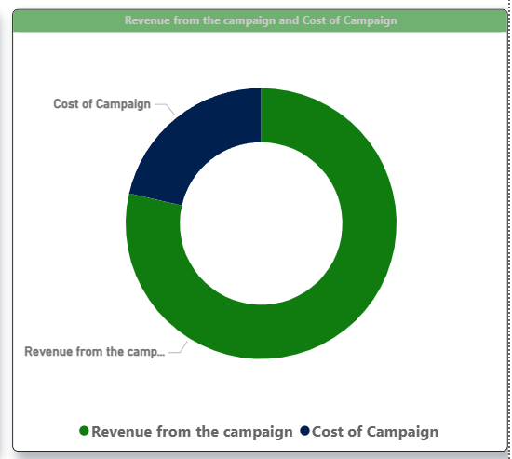
Result:

Slide 10
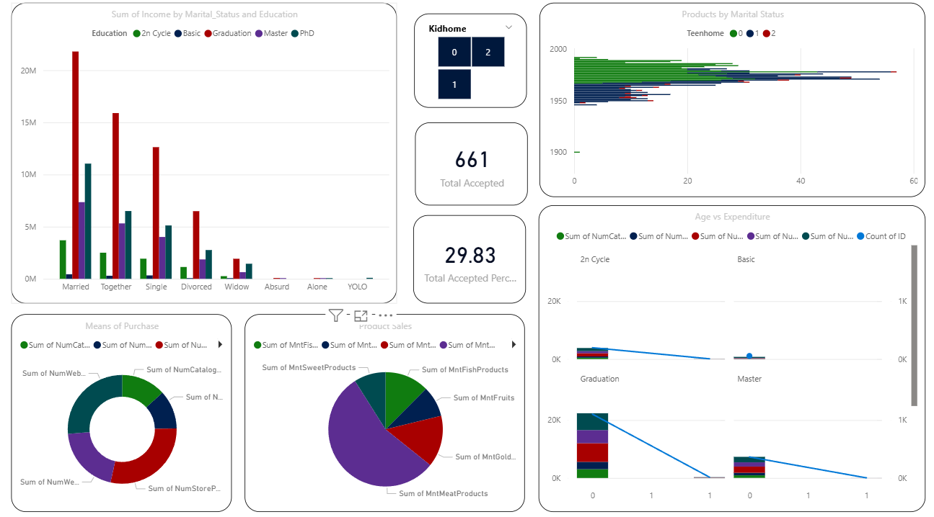
Result:

Slide 11
Conclusion:
The Marketing Campaign Performance analysis using Power BI provides clear visibility into campaign effectiveness and customer behavior.
Interactive dashboards and KPIs enable stakeholders to quickly identify high-performing and underperforming campaigns.
Data-driven insights support better decision-making, improved budget allocation, and optimized marketing strategies.
Power BI’s visualization and reporting capabilities simplify complex data into actionable business intelligence.

Slide 12
Future scope:
Integrate real-time data sources to enable live campaign performance tracking.
Incorporate advanced analytics and machine learning models for campaign response prediction.
Expand customer segmentation using behavioral and predictive analytics.
Automate insights and alerts for performance thresholds using Power BI Service.
Integrate additional data sources such as social media and web analytics for deeper marketing insights.

Slide 13
References:
Chandra Pratap Singh; Rizwan Yousuf et al. (2024): "Enhancing Marketing Strategies Through Big Data-Driven Customer Journey Mapping: An Analysis Using Machine Learning Algorithms," IEEE Access. DOI: 10.1109/INNOCOMP63224.2024.00084.
Milena Vuckovic; Dawid Wolosiuk; Johanna Schmidt. et al. (2024): "Designing Interactive Analytics Dashboards for Diverse Target Groups: The Process and Decision-Making," IEEE Access. DOI:10.23919/SpliTech61897.2024.10612622.
Wissam Nazeer Wassouf, Ramez Alkhatib, Kamal Salloum & Shadi Balloul et al. (2020): "Predictive analytics using big data for increased customer loyalty: Syriatel Telecom Company case study," Springer
GitHub Link: https://github.com/rohanrodu/Marketing-Campaign-Performance

Slide 14
Thank You

